Slide 1
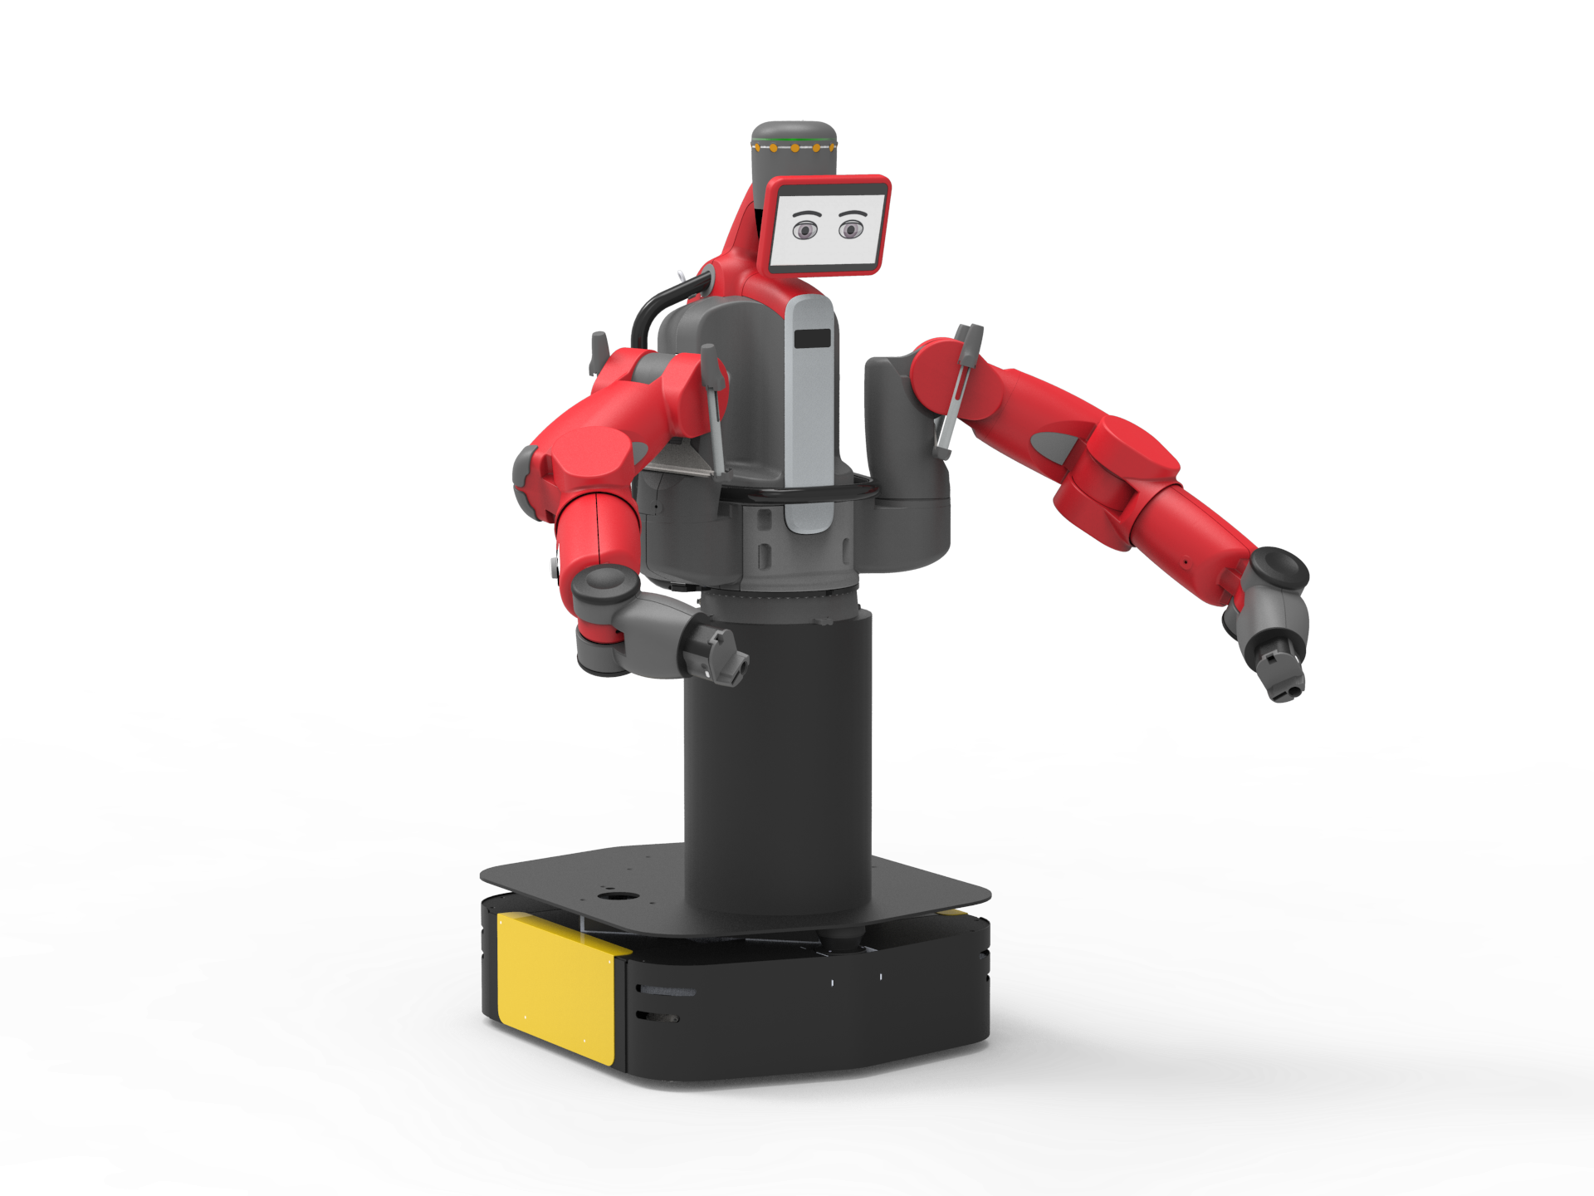
Teaching Baxter to Use Tools
Patrick, Valerie, Yi Chern
Team Baxter
Notes:
EVERYONE

Slide 2
Project Statement
Given known tasks and tools, Baxter will learn to solve the inverse kinematics for a novel tool, and use that tool to accomplish a specific task.
Notes:
PATRICK

Slide 3
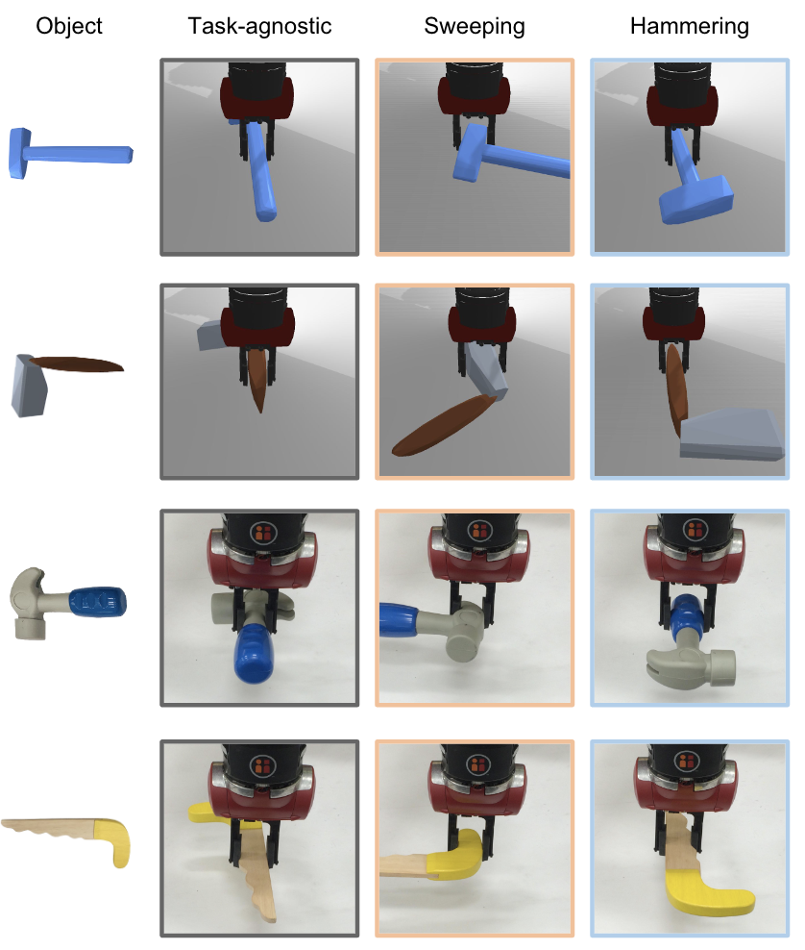
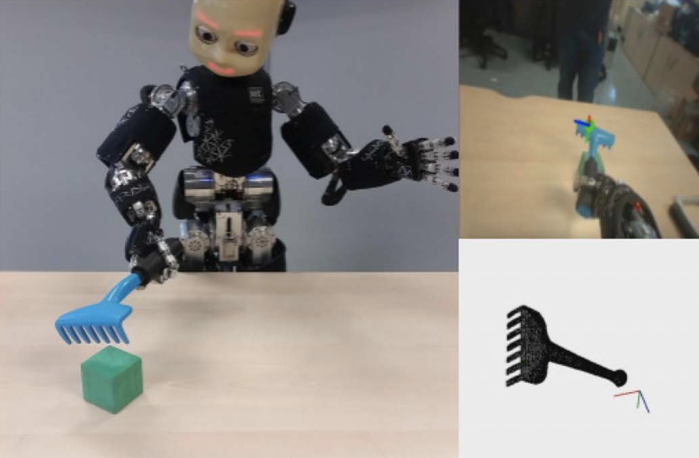
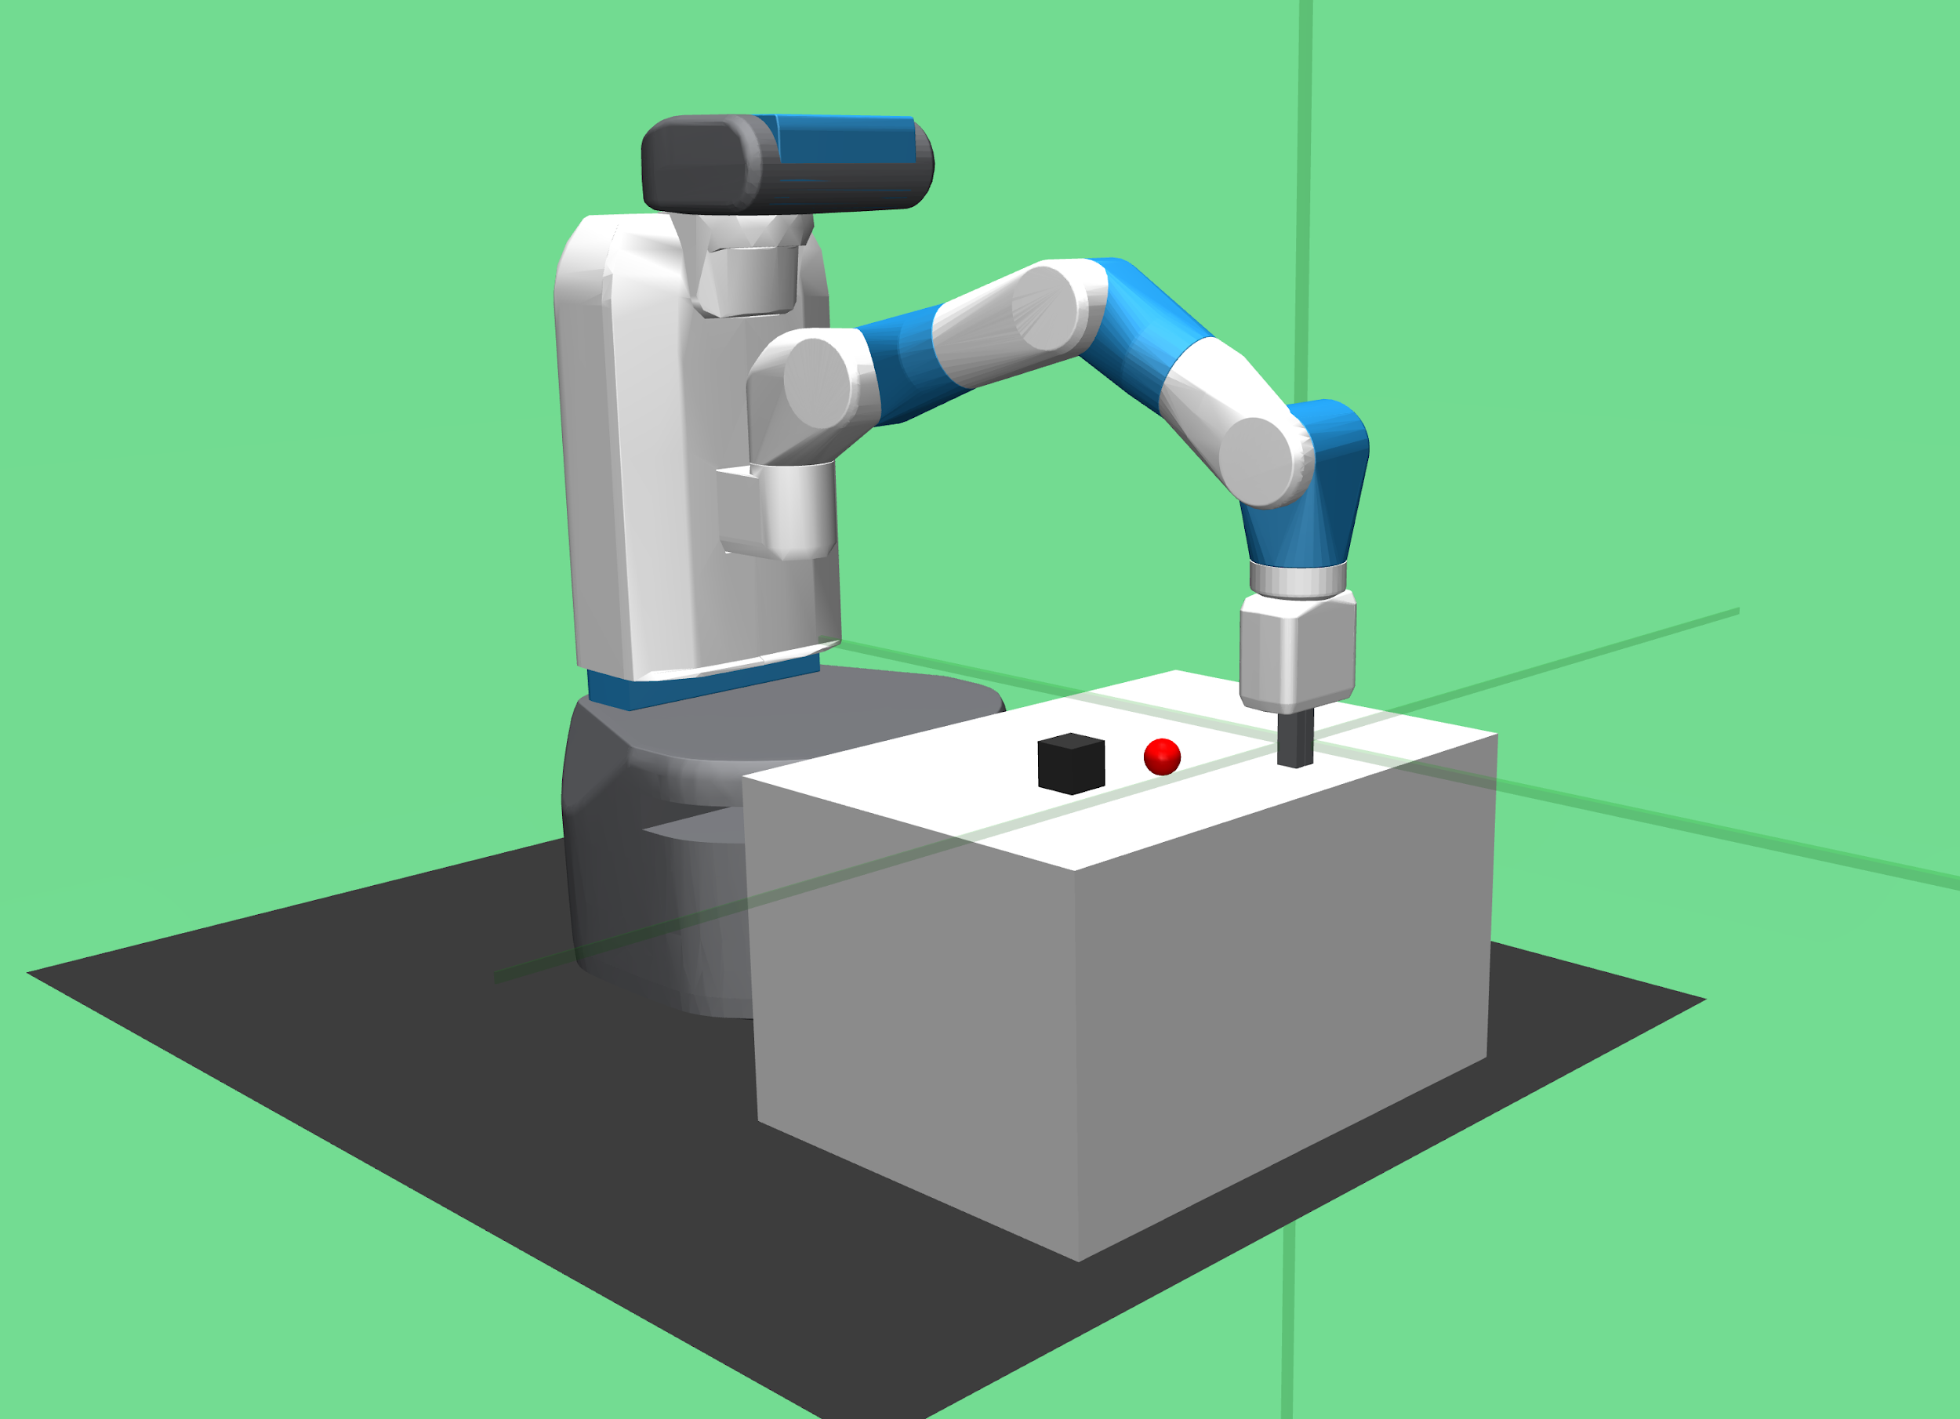
Lit Review
Learning task-oriented tool grasps [1]
Goal based robot reinforcement learning (OpenAI) [2]
Robot learning tool affordances [3]
[1] Fang, K., Zhu, Y., Garg, A., Kurenkov, A., Mehta, V., Fei-Fei, L., & Savarese, S. (2018). Learning task-oriented grasping for tool manipulation from simulated self-supervision.
[2] Plappert, M., Andrychowicz, M., Ray, A., McGrew, B., Baker, B., Powell, G., ... & Kumar, V. (2018). Multi-Goal Reinforcement Learning: Challenging Robotics Environments and Request for Research.
[3] Mar, T., Tikhanoff, V., & Natale, L. (2018). What Can I Do With This Tool? Self-Supervised Learning of Tool Affordances From Their 3-D Geometry.
Notes:
VALERIE
https://www.technologyreview.com/s/410405/a-robot-that-learns-to-use-tools/

Slide 4
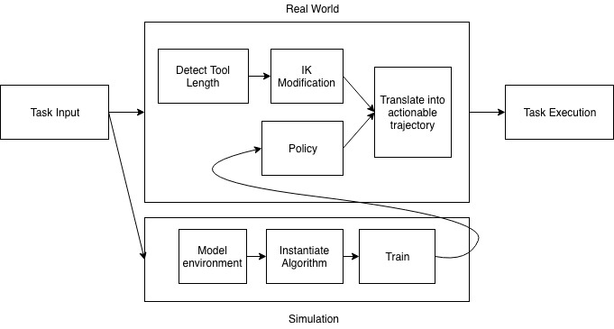
Workflow
Notes:
VALERIE
I can change the colors/remove background later if needed.

Slide 5
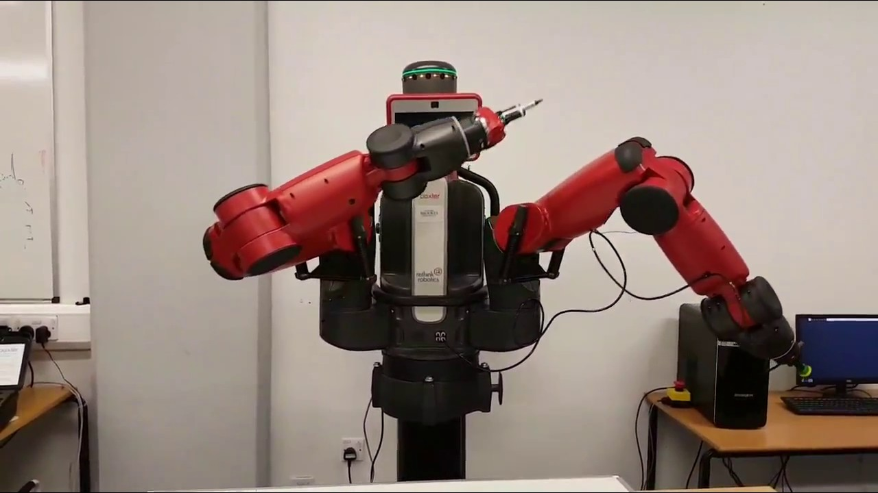
Real Baxter
Rethink Robotics: joint angle vector
[right_s0, right_s1, right_e0, right_e1, right_w0, right_w1, right_w2]
Scazlab : inverse kinematic solver
[x, y, z, [i, j, k, w]]
Tasks:
Vision to detect tool length
Extend IK solver
Notes:
PATRICK

Slide 6
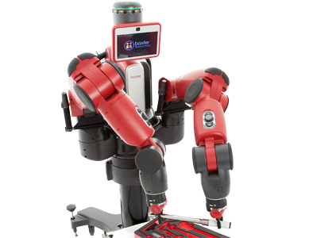
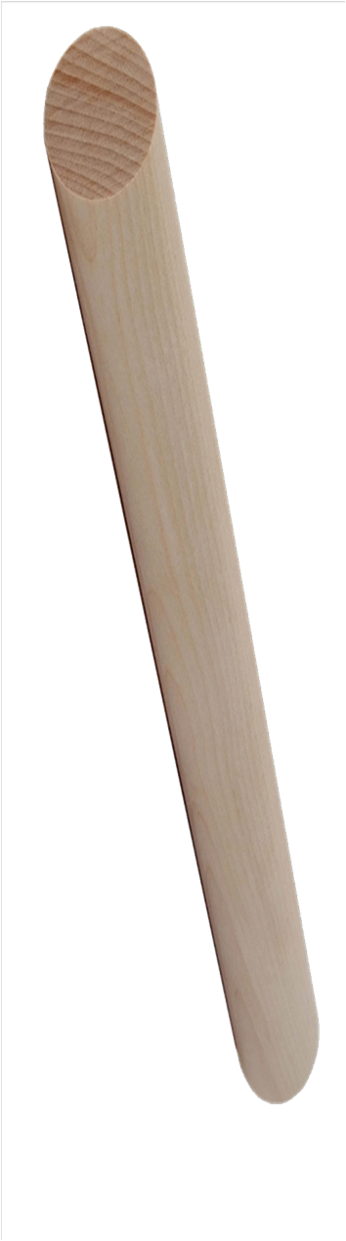
Selected Task: Part 1
Move tool tip to specified 3D space location
Notes:
PATRICK

Slide 7
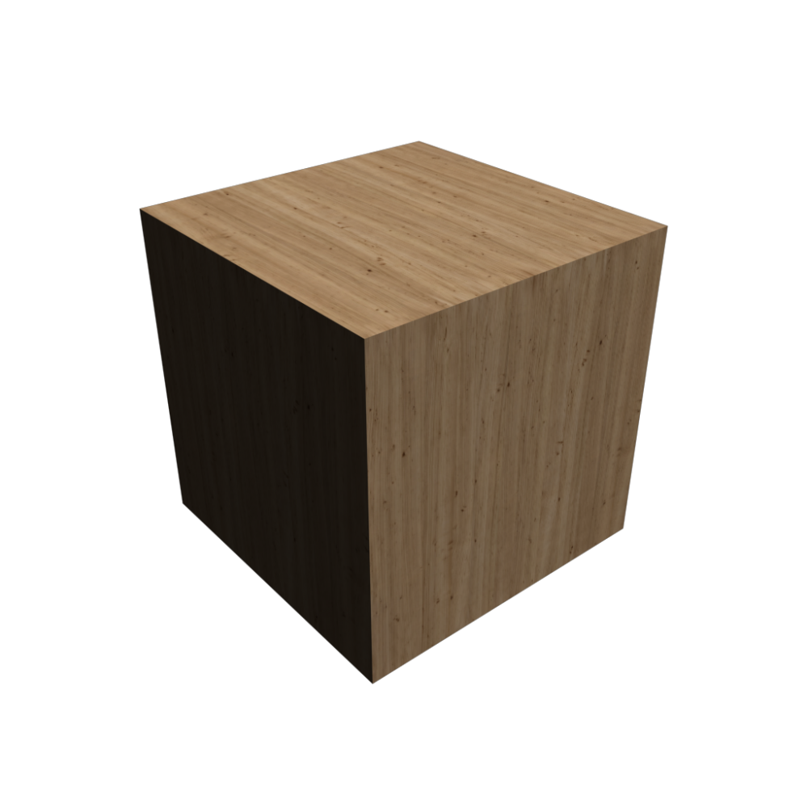
Selected Task: Part 2
Use tool (wooden dowel) to sweep the box
Notes:
PATRICK

Slide 8
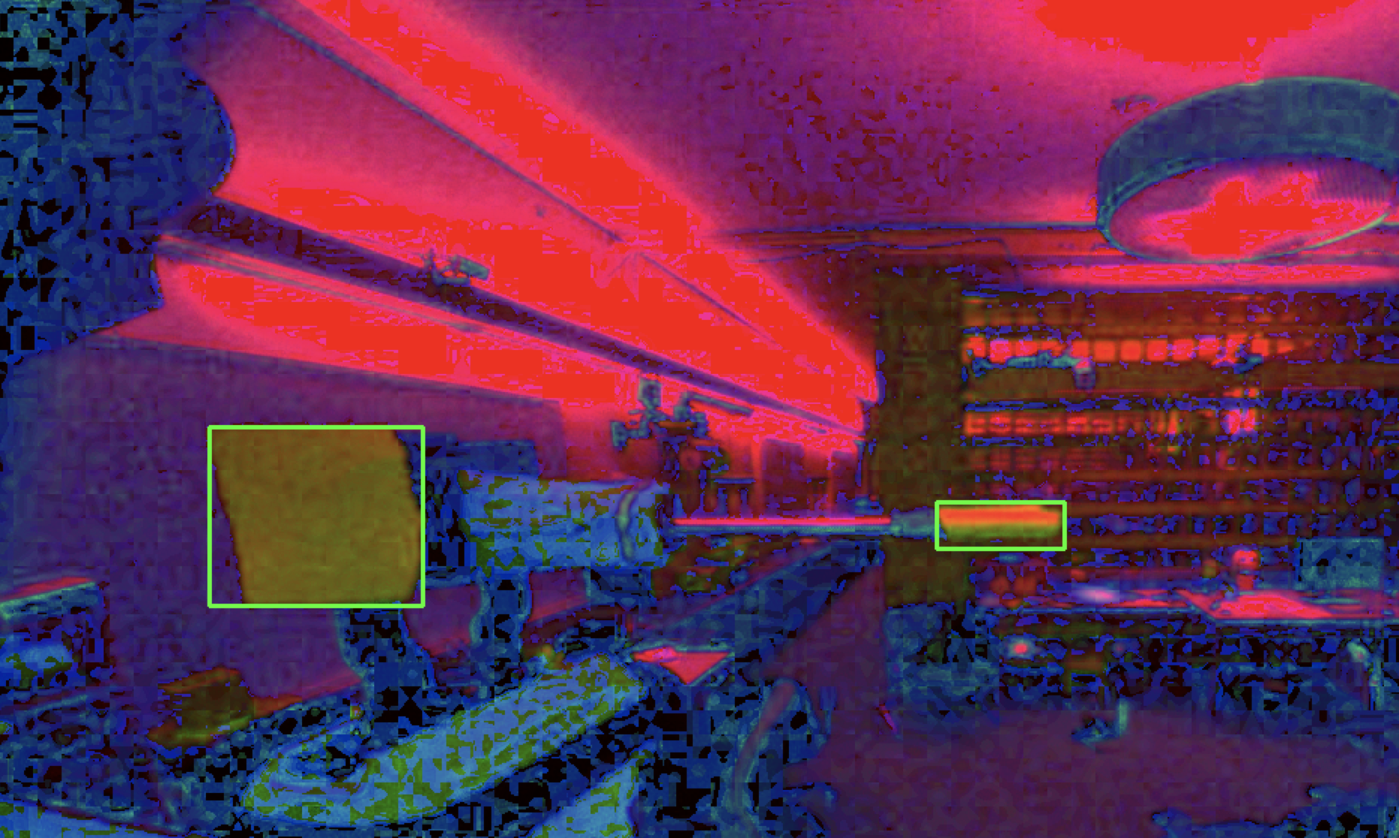
Detecting Tool Length using vision
Given 3 images at fixed locations, using OpenCV
Convert to HSV
Blur
Detect color at ends of tool
Draw bounding box around each end
Determine coordinates of ends in pixel space
Scale number of pixels to real life measurements
Notes:
PATRICK
Only handling long straight tools like this

Slide 9
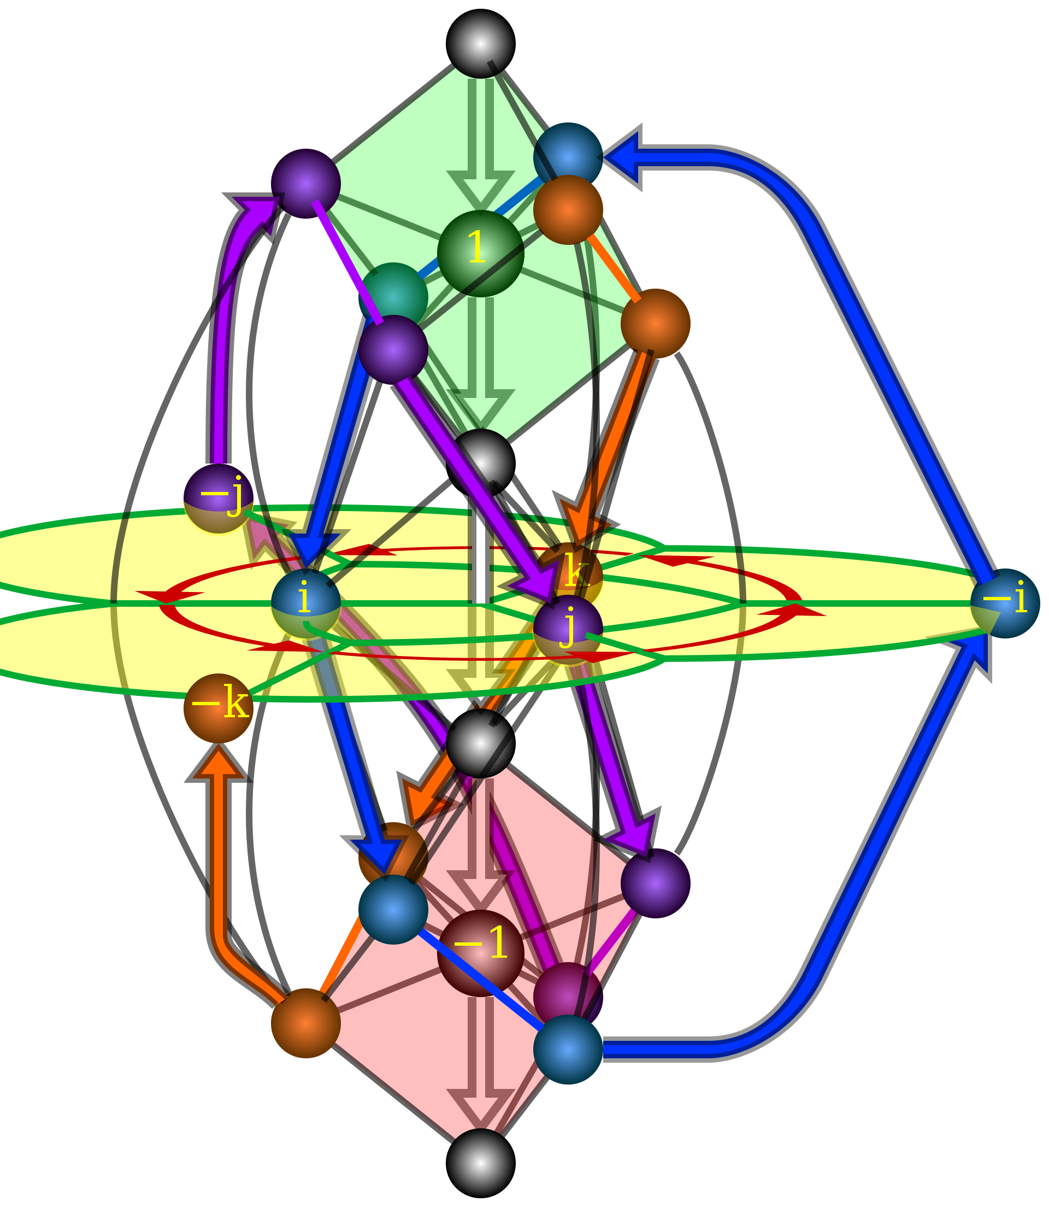
Modifying IK Solver
Tool length offset trivial for fixed orientation
How to adjust for arbitrary orientation?
Quaternions!
Represent offset as vector and transform
Subtract new vector
v’ = q v q^-1
Notes:
PATRICK

Slide 10
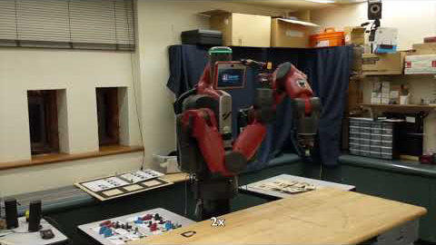
ADD VIDEO HERE
Notes:
PATRICK

Slide 11
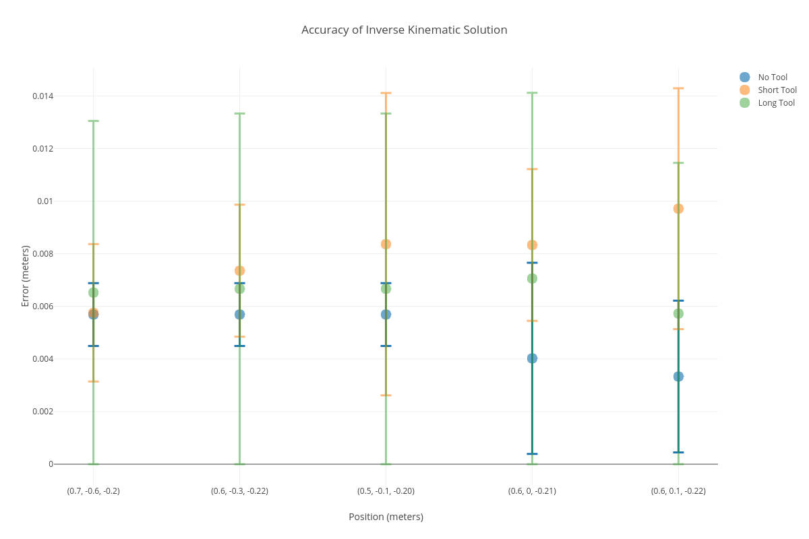
Results - IK modifications
Notes:
PATRICK

Slide 12
Simulation Baxter
Tasks:
Set up environment so that it models the real Baxter and task
Measurements, joint angles, environment
Determine RL algorithms
Train models
Collect learned (and smoothed) trajectory points to pass to real Baxter
Evaluate performance in simulation and with transfer
Notes:
YICHERN

Slide 13
Simulation Set up
OpenAI Gym: RL framework (https://github.com/openai/gym)
MuJoCO: Physics engine + Simulation
mujoco-py: Python wrapper for MuJoCO (https://github.com/openai/mujoco-py/tree/master/mujoco_py)
XML model of Baxter and environment (table, box, tool)
Based off of Fetch from OpenAI Gym
Baselines: RL algorithms (https://github.com/hill-a/stable-baselines/tree/master/stable_baselines)
Notes:
YICHERN

Slide 14
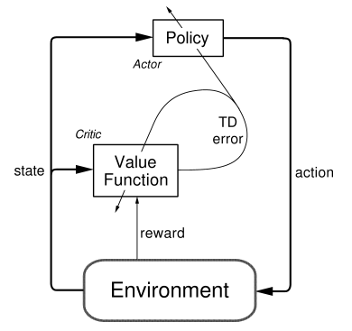
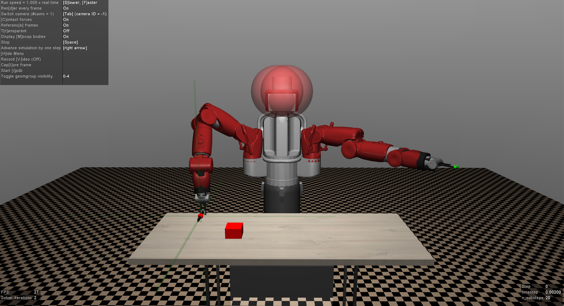
Environment
In addition to the robot and environment XML file, must define:
Points in environment to observe during training
Reward function
Distance from current box position to goal
Distance from tool to the box
Degrees of freedom
Joint position and rotation
Measurements of real world objects
Action space
Goal location
Success state
Notes:
YICHERN
Talk about reward functions that we looked at

Slide 15
RL Algorithms
Algorithm | Overview
A2C: Advantage Actor Critic | On-policy, policy gradient update
TRPO: Trust Region Policy Optimization | On-policy, policy gradient update with largest advantage and constraint on new policy via KL divergence
PPO: Proximal Policy Optimization | On-policy, policy gradient update with largest advantage and constraint on new policy via clipping
DDPG: Deep Deterministic Policy Gradients | On-policy and off-policy, concurrently learns Q-function and policy, by using each to improve the other
Notes:
YICHERN
ADD STUFF ABOUT EACH ONE!
Cite the original papers
Generally talk about how long it took to train
Actor Critic Network
one that’s used for doing predictions on what action to take given the current environment state and another to find the value of an action/state

Slide 16
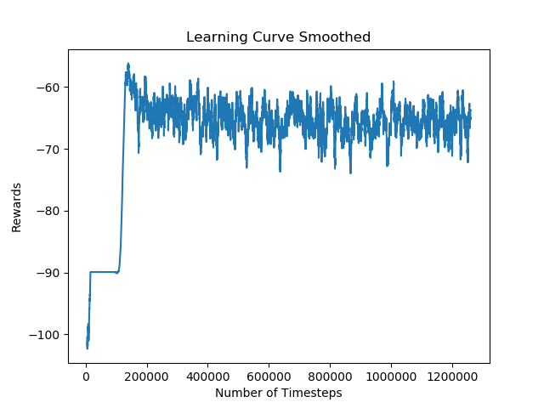
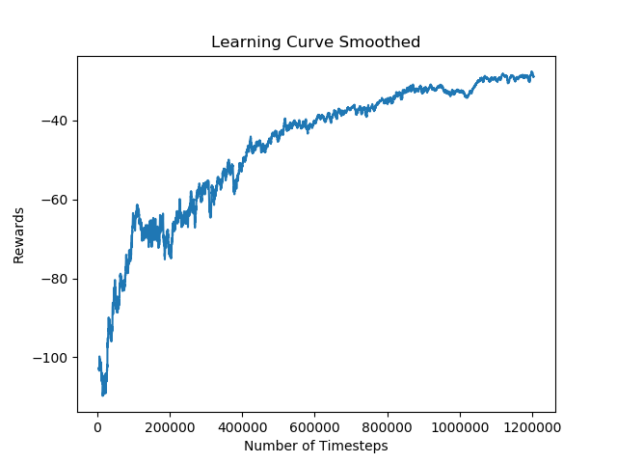
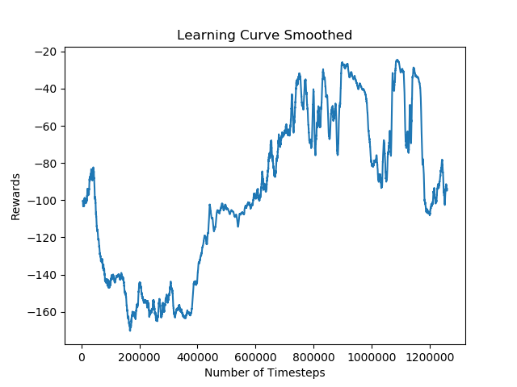
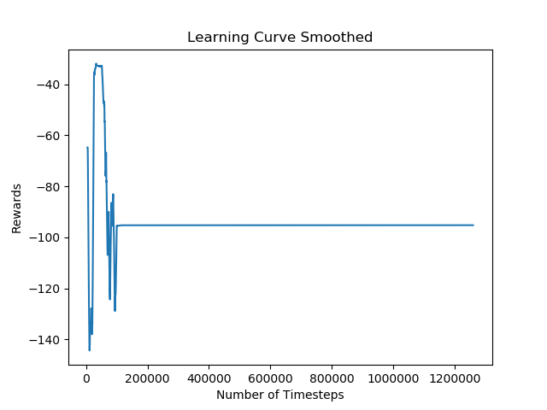
Results - Comparing Algorithms
A2C
TRPO
PPO
DDPG
0.409 | 0.119 | 0.0774 | 0.351
Distance from Goal State at End of Episode (m)
Notes:
PPO: Alright
A2C: Unpredictable behavior
TRPO: converges quite smoothly
DDPG: Flat

Slide 17
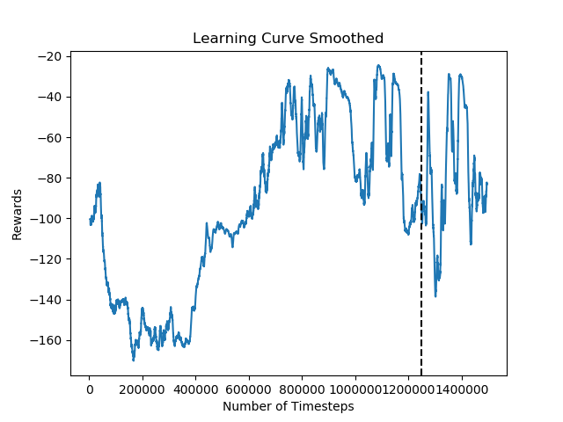
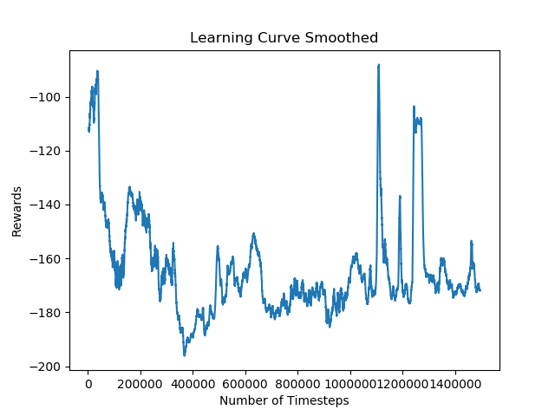
Results - Fine Tuning
Initial Position
Goal State 1
Goal State 2
Fine tuned
From Scratch
0.213 | 0.351
Distance from Goal State at End of Episode (m)
Notes:
YICHERN
Possibly include the DDPG results after too?

Slide 18
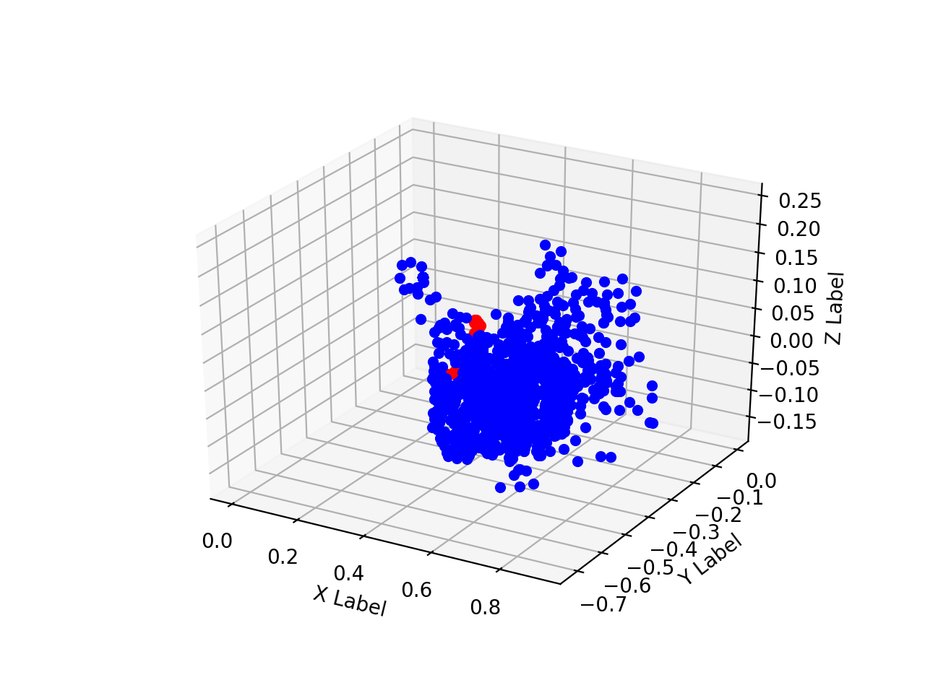
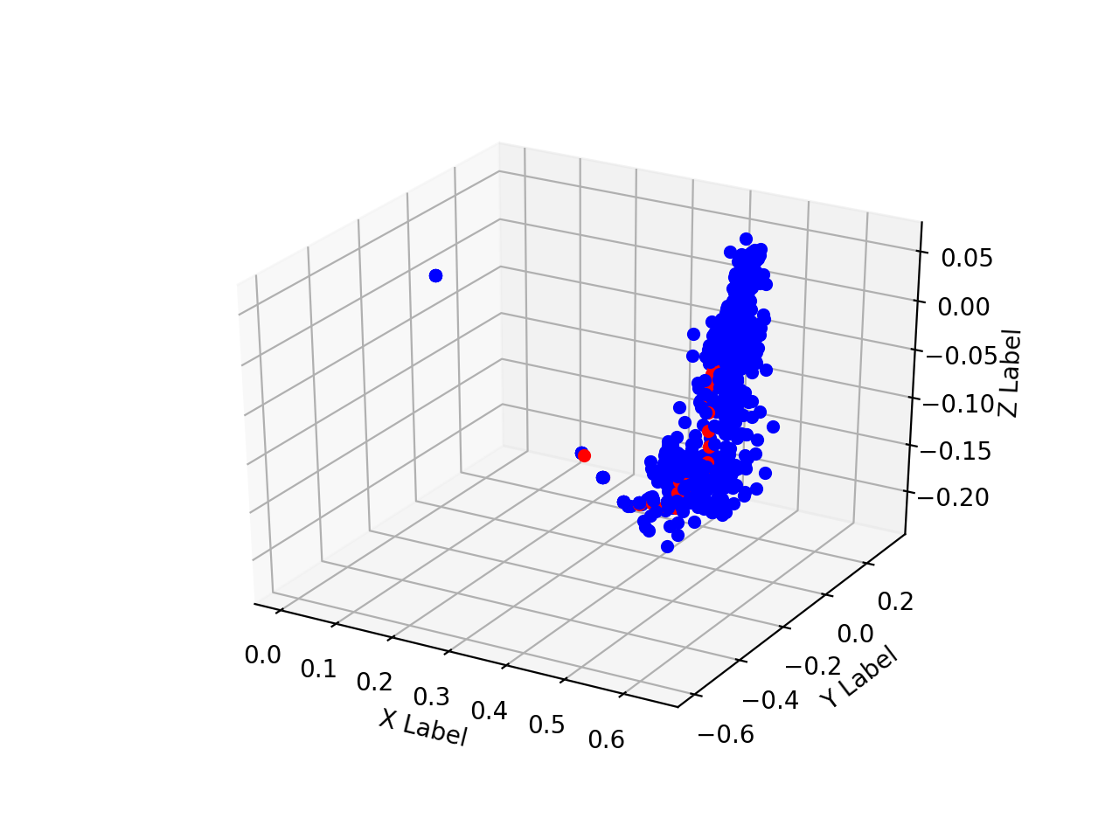
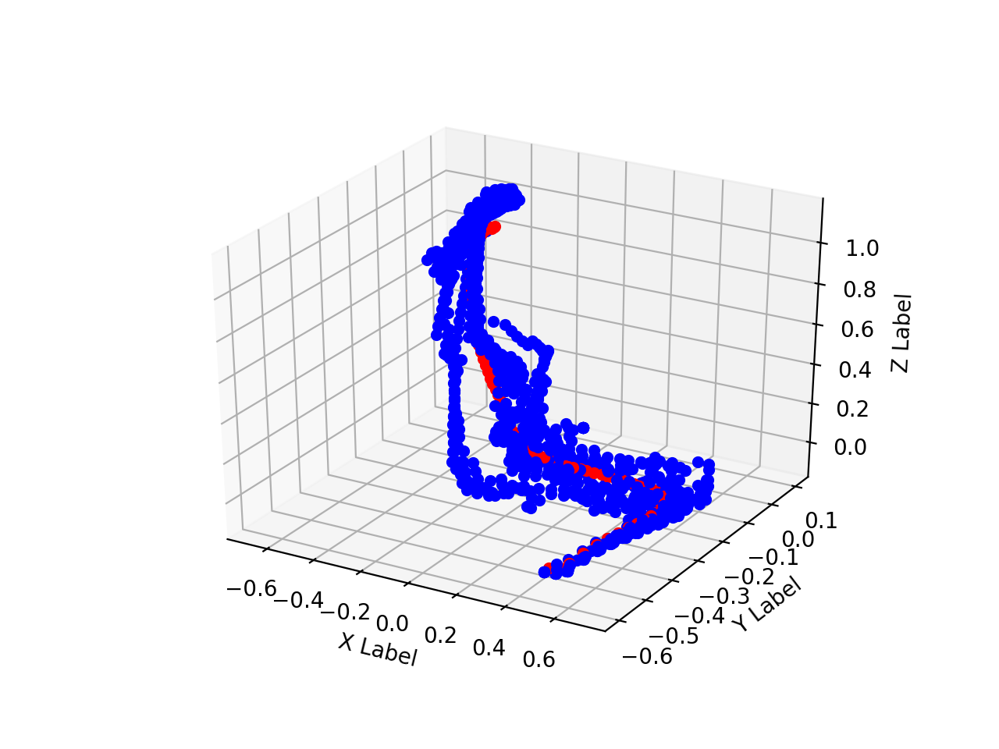
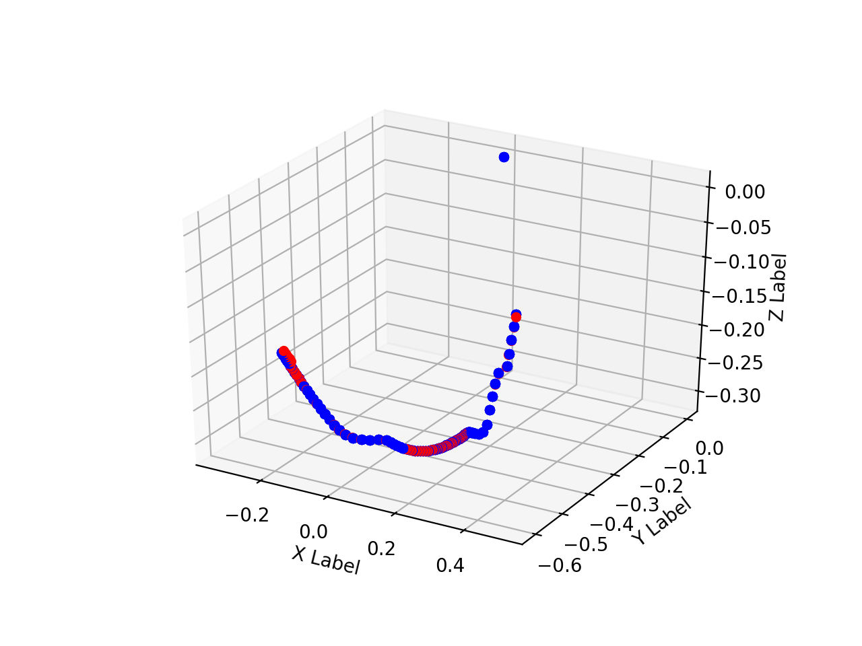
Results - Learned Path Trajectory
A2C
TRPO
PPO
DDPG
Notes:
YI CHERN
How stable is the path?

Slide 19
Sim2Real Transfer
Learned
Policy
Calculate smooth trajectory using 100 runs
Pass to real Baxter
Notes:
VALERIE

Slide 20
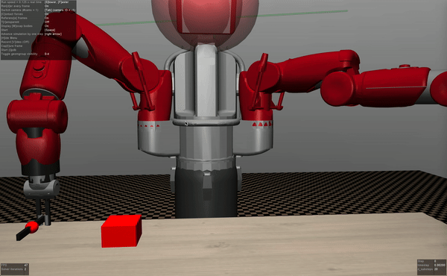
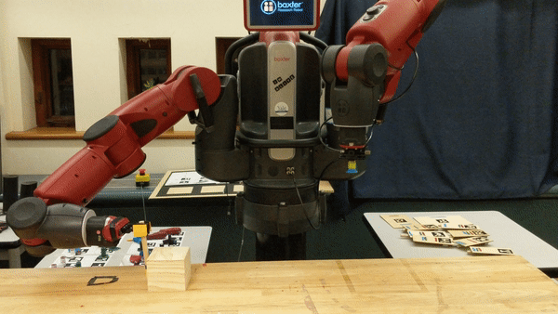
Results - Comparing Simulation & Real
Notes:
VALERIE
Difference between simulation and real life.. Mention that even though looks really similar but once fully rotate, not as far along on y axis as simulation is. Therefore we measured absolute change from starting and end (starting from
Ran this
https://youtu.be/sFyjjf0uEQ

Slide 21
Discussion
RL Algorithms
PPO2 seemed to produce most stable real world results
Sim2Real Possibilities & Limitations
Benefits of training in simulation => transfer to real world
Correspondence between real world and simulation baxter possible
However, difficulties arise in real world with speed of IK solver hitting orientations it cannot reach/baxter movement, forces, etc
Notes:
VALERIE
Perhaps we can add the shift up first and then go to the real point

Slide 22

Future Work
A more generally learned model to incorporate a greater variety of tasks and tools
Notes:
VALERIE

